Slide 1
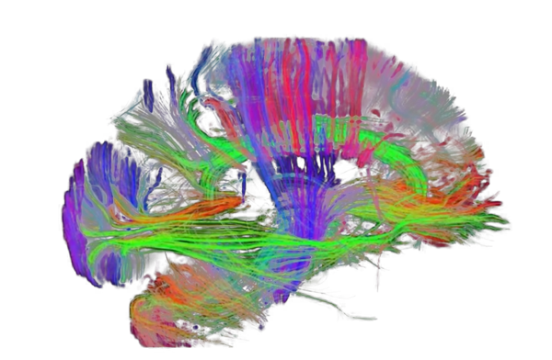
Brain networks

Slide 2
Brain networks
Transition from region-specific to network-focused research.
Modern neuroimaging studies (fMRI), combined with data science techniques (machine learning) highlight regions that activate in correlative fashion when certain tasks or thoughts are occurring.
Insight into brain functionality through connections.
The Human Connectome Project: A leap in brain mapping.
Brain network comprises of seven major brain networks and several important sub-networks
Future direction for personalized brain medicine.
What network of the brain is responsible for each function?
Where are the different areas of this network located, and how are they connected?

Slide 3
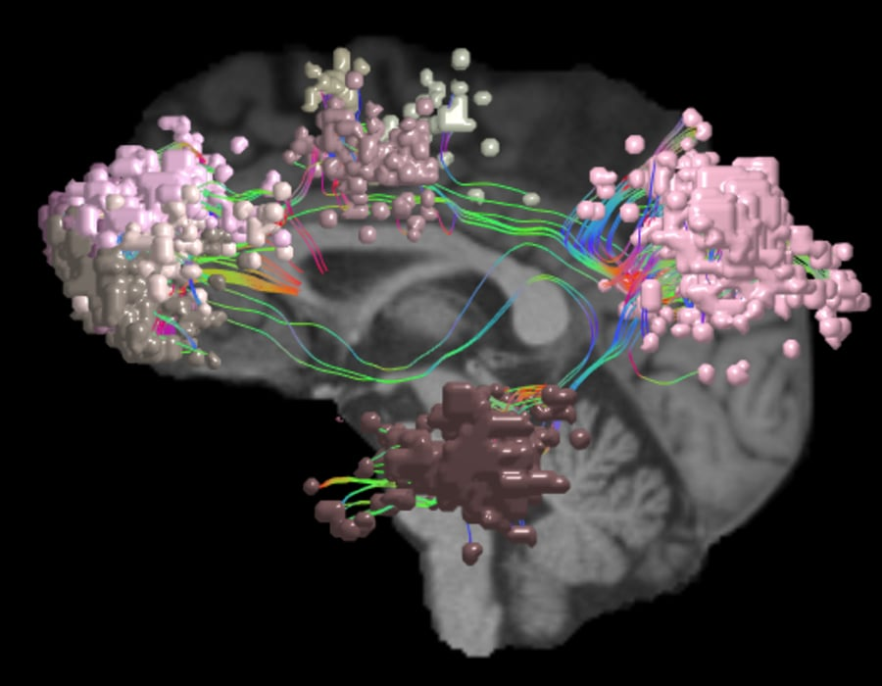
Central Executive Network
Responsible for tasks and decision making, the central executive network (CEN), also known as the frontoparietal network, acts as “the external mind.”
CEN performs high-level cognitive tasks, and works alongside or in anticorrelation with the other six main brain networks.
The CEN engages in:
Active tasks and external thinking involving working memory
Controlled processing of information
Integration of information from the other brain networks
Rule-based problem solving and decision making
Consideration of multiple, independent stimuli and independent factors
Organizing behavior based on internal drives, subjective preferences, and choices
Reinforce visually learned behaviors
The central executive network has been found to be functionally connected to regions in the:
Anterior cingulate cortex
The inferior parietal lobe
The posterior most portions of the middle and inferior temporal gyri

Slide 4
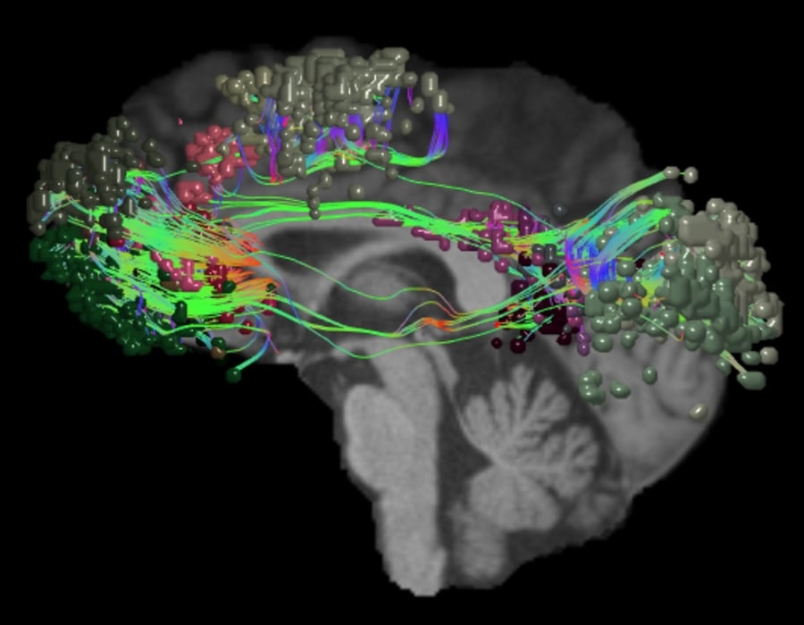
Default mode network
The default mode network (DMN) is the “internal mind.”
The role of the DMN
Due to its frequent activity, DMN plays an integral role in coordinating with other networks for passive sensory processing.
These connections often include:
Visual processing in conjunction with the visual system when the mind subconsciously appreciates aesthetic beauty, like observing impressive artwork or architecture.
Semantic processing with the language subnetwork when encoding or translating meaning into spoken or written words.
Processing or evaluating personal emotions or the emotions of others, with the limbic system.
The default mode network is structurally and functionally connected to
the medial temporal lobe
the medial prefrontal cortex
the posterior cingulate cortex
ventral precuneus
parts of the parietal cortex.

Slide 5
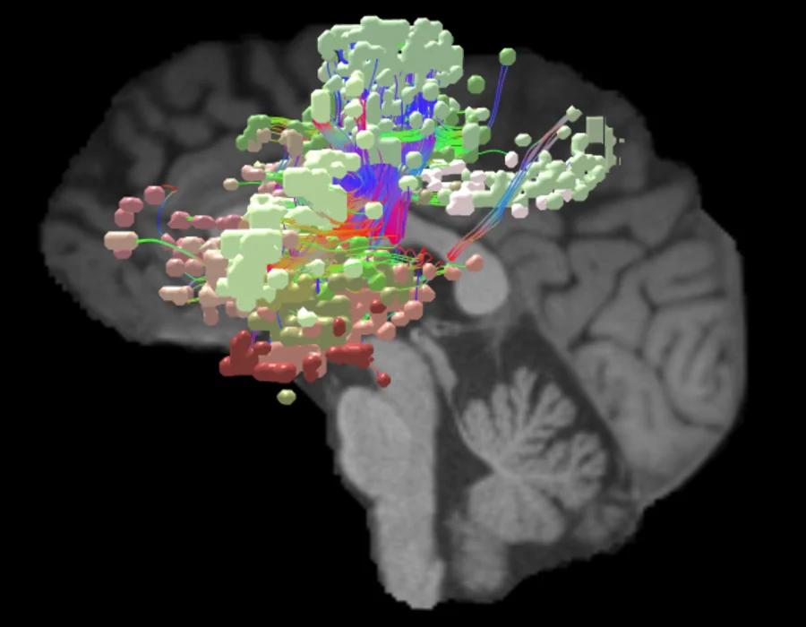
Salience network
The salience network (SN) is “the moderator.”
The salience network constantly monitors the external world and carefully decides how other brain networks react to new information and stimuli.
The SN moderates switching between the internal and external processing of the brain’s two main control networks: DMN and CEN.
In healthy brains, these two networks are not active at the same time. To avoid missed information or mixed messages, the SN determines which network is in control at any given moment.
The main functional areas, or nodes, of the salience network are located in:
the anterior cingulate
the anterior insula
the presupplementary motor areast
amygdala, hypothalamus, ventral striatum, thalamus, and specific brainstem nuclei
anterior cingulate cortex (ACC), medial temporal network, parahippocampal gyrus, olfactory lobe, and the ventral tegmental area (VTA).
Notes:
The salience network is solely responsible for regulating the switch between these two control networks, and it determines which network is in control at any given moment. Additionally, the SN is also responsible for regulating emotion and pain from the other main networks. The SN regulates these changes so quickly and effectively that the process is typically imperceptible to the human mind.
However, the SN can have negative implications for the brain when it becomes overactive and abnormally handles network switching or emotional regulation. These irregularities can lead to mental illness, such as schizophrenia, depression, anxiety, and post-traumatic stress disorder. Analyzing the brain's neural networks opens up a range of possibilities to diagnose and treat these neuropsychiatric disorders.

Slide 6
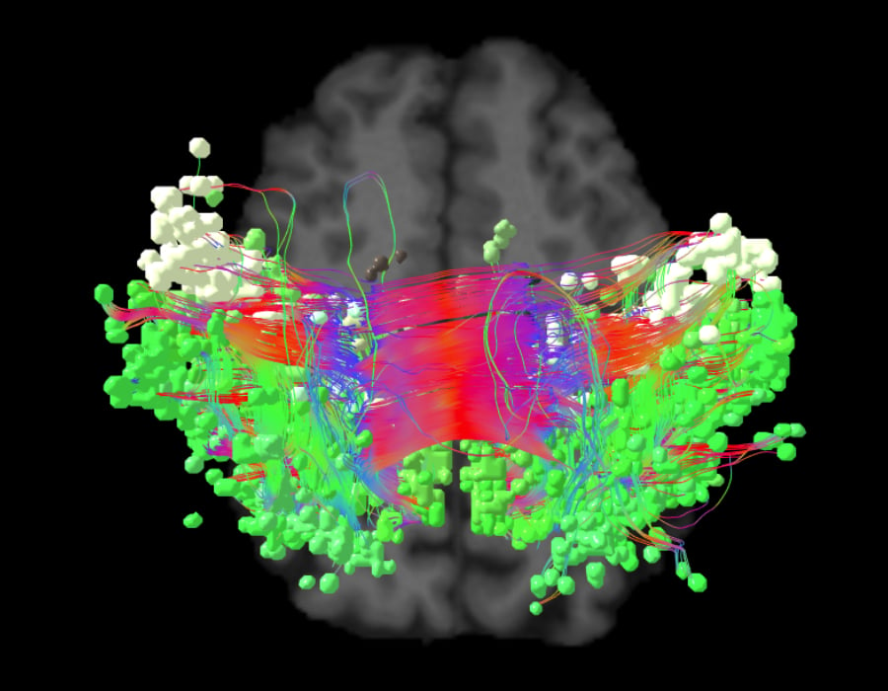
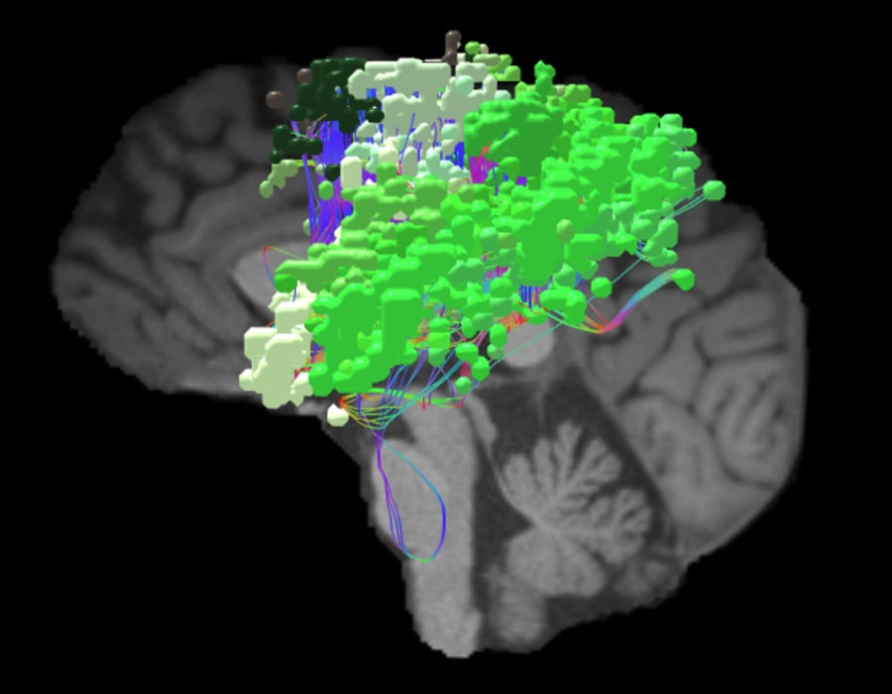
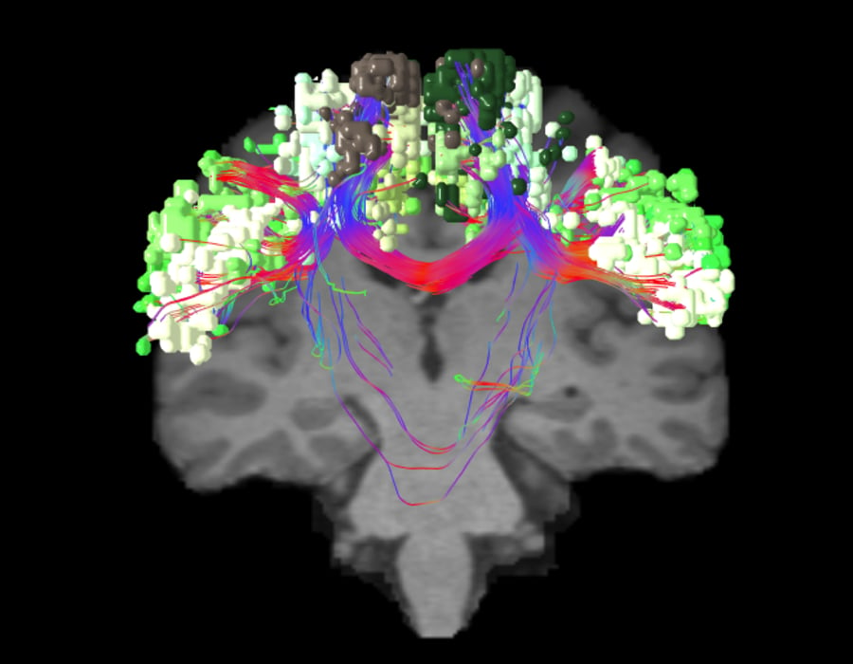
Sensorimotor or Somatomotor
The sensorimotor network is “the transducer.”
Responsible for sensing physical inputs, converting them to electrical signals that travel throughout the brain network, and then initiating a physical response
The sensorimotor network is responsible for:
Processing external physical stimuli
Feeling internal sensations
Evaluating the senses
Producing a motor response
AXIAL VIEW
SAGITTAL VIEW
CORONAL VIEW

Slide 7
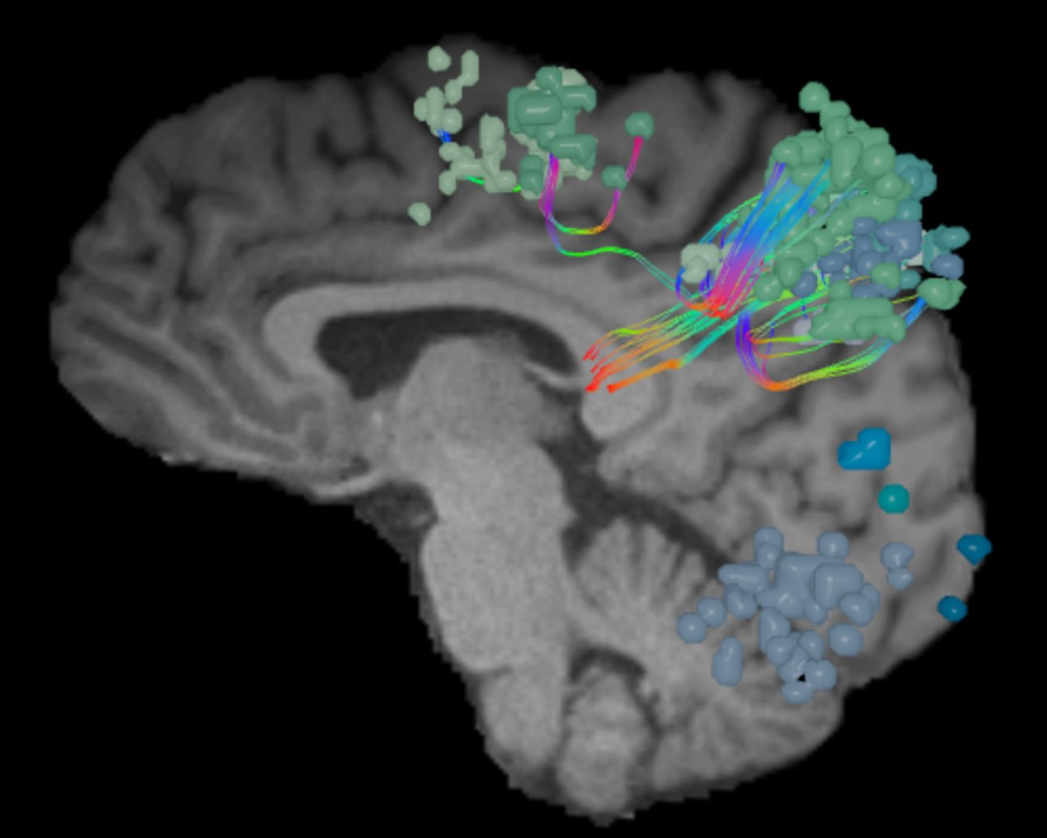
Dorsal Attention network
As the network that focuses human attention, the dorsal attention network (DAN) is the brain’s “aperture.”
The DAN is a consistent, bilateral network for the steady holding of attention, and it has many ways of contributing to intellectual capabilities.
The human brain receives sensory input constantly, and it cannot equally attend to every sensory signal at all times
The DAN focuses the brain’s attention to hone in on a particular moment’s most important sensory inputs.
The DAN is a bilateral network.
Demonstrates strong connectivity between areas in
the lateral occipital lobe
the pre-central sulcus
the dorsal-most portion of the superior frontal sulcus considered to be the frontal eye fields (FEF)
the ventral premotor cortex
superior parietal lobule
intraparietal sulcus
motion-sensitive middle temporal area

Slide 8
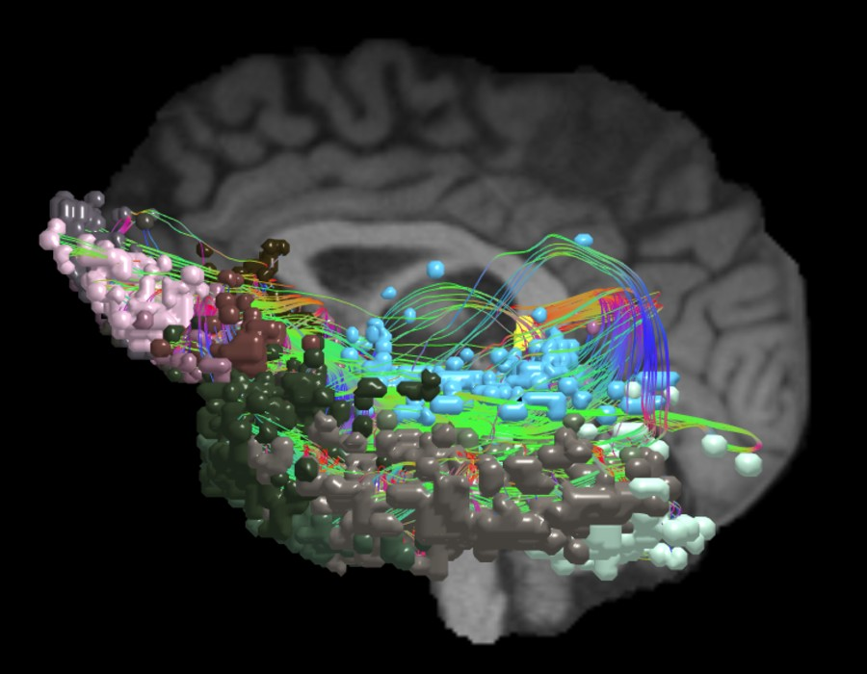
Limbic network
In the human brain, the limbic system is “the regulator.”
The limbic system has been found to regulate many core brain functions, including response, reaction,1 behavior, emotion, memory, and learning.
The limbic system has developed throughout the course of evolution to regulate core functions in mammals and humans. These processes often take the form of:
The response to a stimulus, such as a new smell, sound, or sight
The level of reaction or motivation, be it self-protection or reward-seeking
The behavior that ensues the emotion associated with that response or behavior
The memories formed based on the experience
Any learning or takeaways from the experience
The limbic system generally includes
the amygdala, thalamus, hypothalamus, hippocampus
numerous functionally and anatomically-related areas that are considered paralimbic structures which include
the prefrontal-limbic system
anterior cingulate cortex (ACC)
medial temporal network
parahippocampal gyrus
olfactory lobe
the ventral tegmental area (VTA).

Slide 9
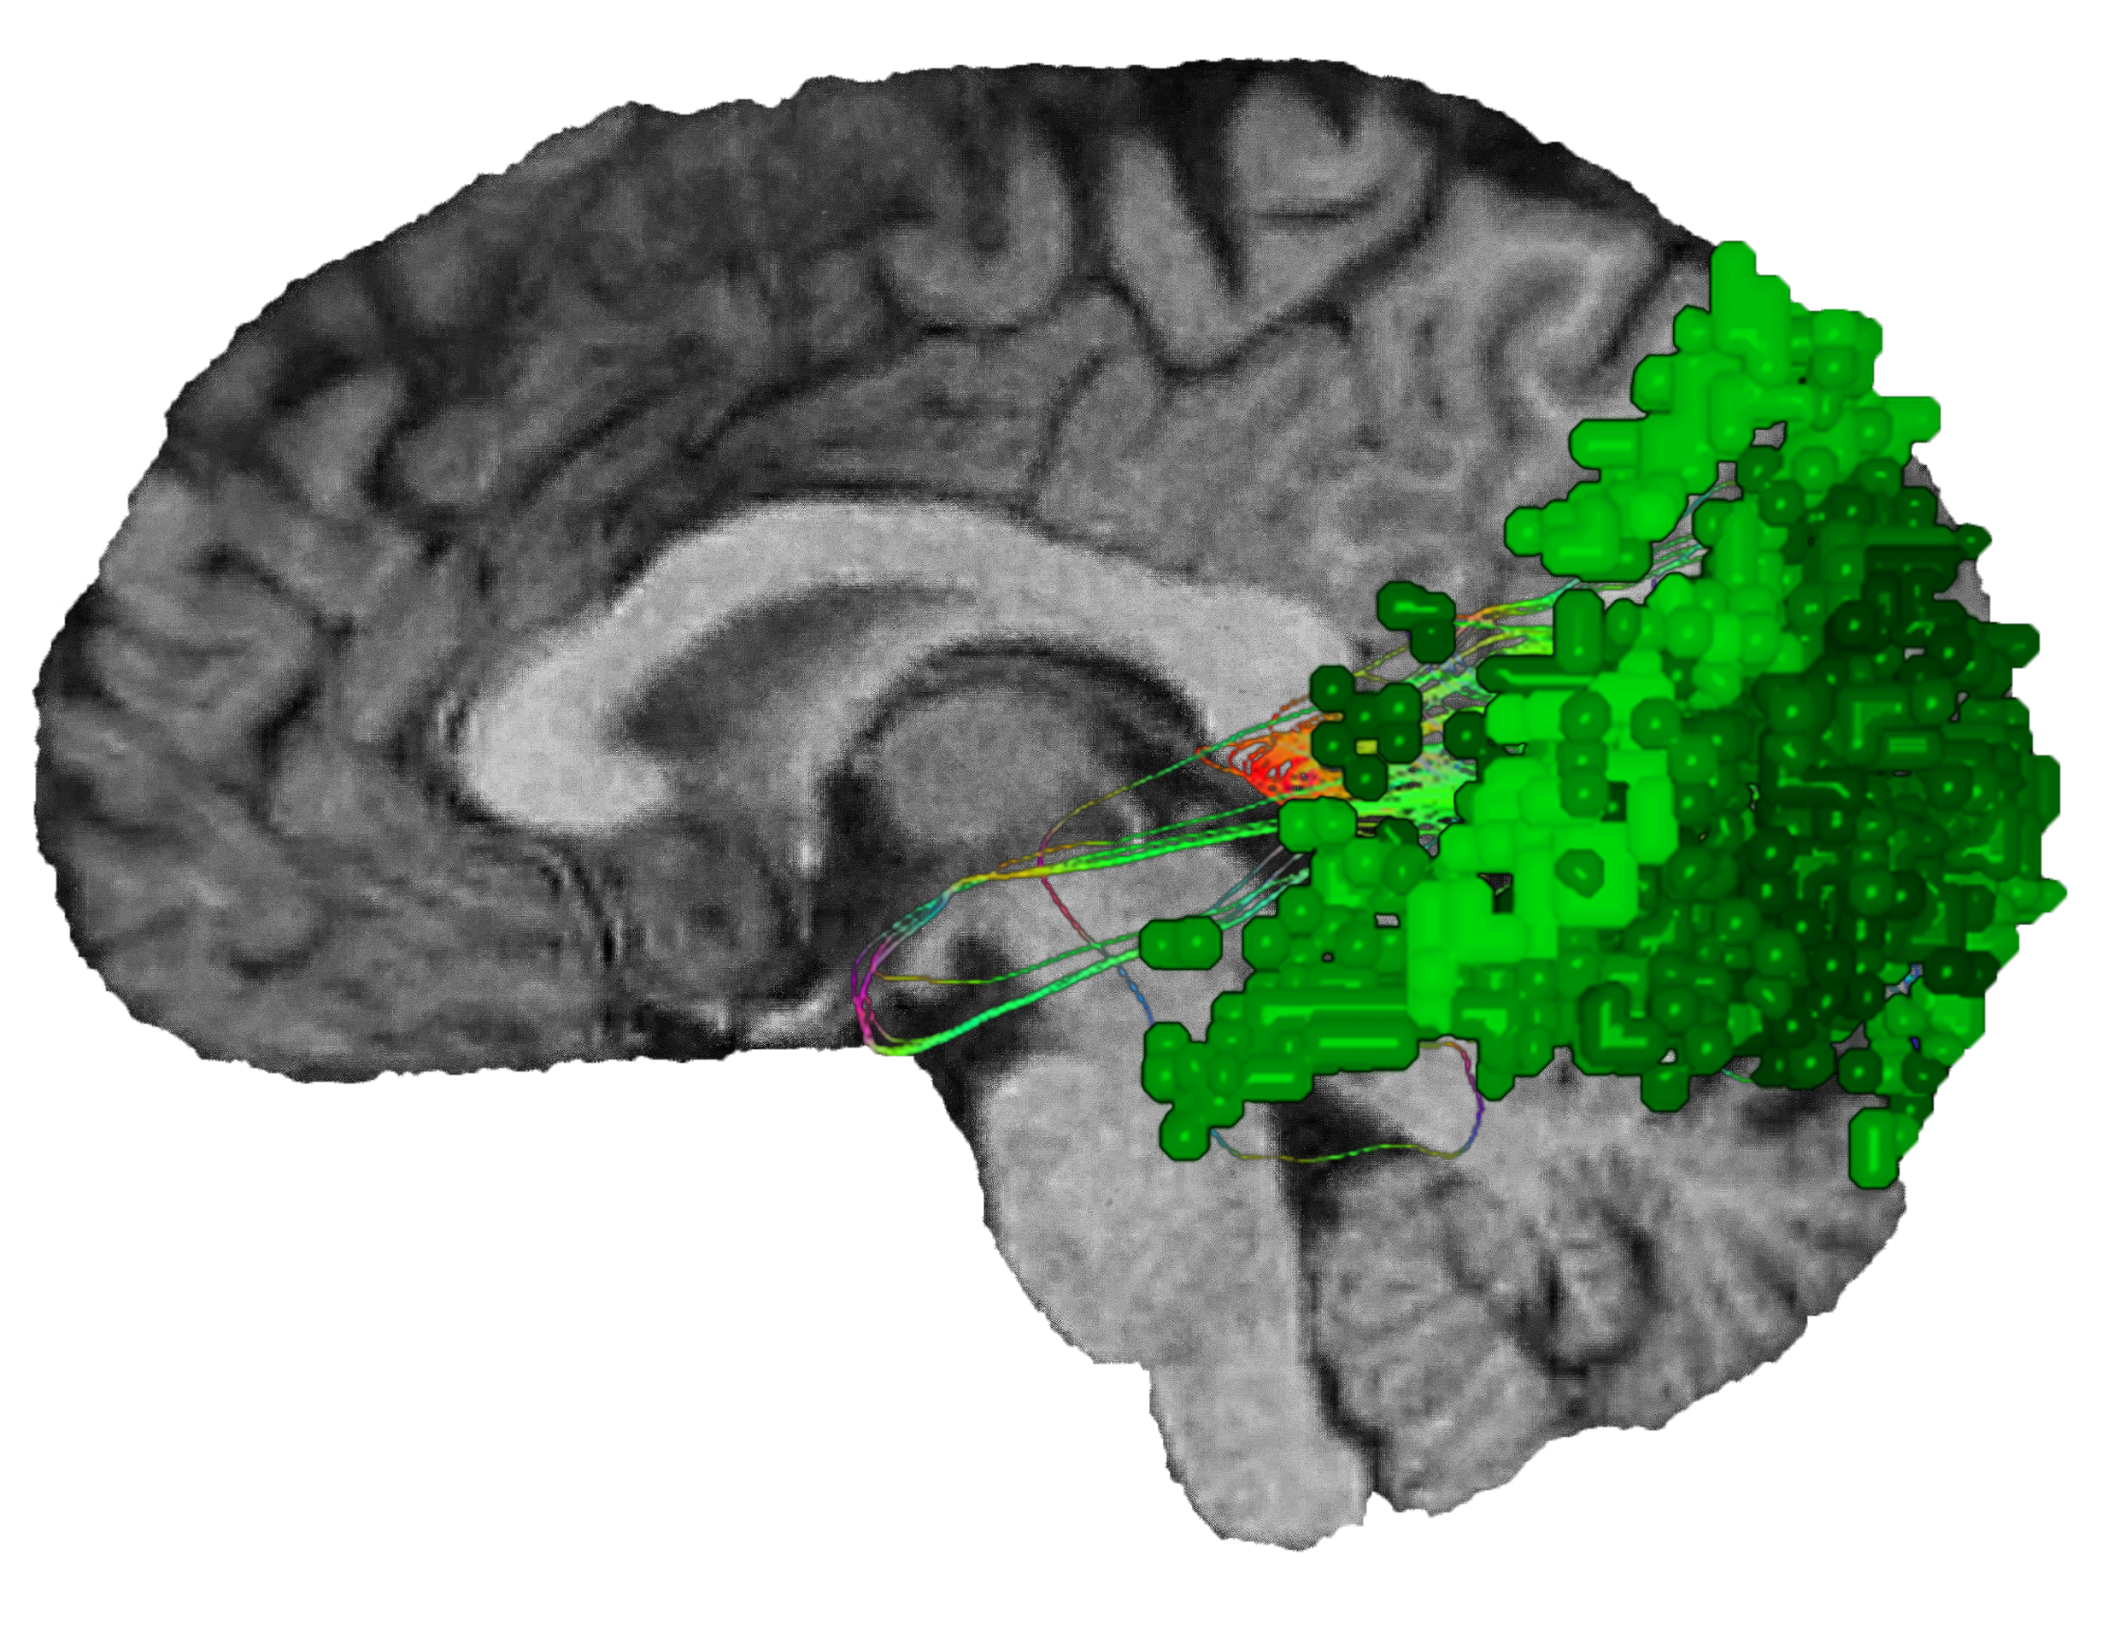
Visual (Occipital) network
The visual system’s name best describes its function as “the observer.”
The visual system controls sight and visual processing.
Works toward the common goal of turning light into something recognizable.
Together, they:
Engage in visual processing
Analyzing motion
Recognize patterns, textures, and faces
Identify the location of objects, buildings, or people in space
Determining the function and permanence of objects
Aid in problem solving
Reinforce visually learned behaviors
The visual system works closely with many of the brain’s networks:
Dorsal attention network (DAN) for reading and general visual processing.
Sensorimotor network for early development and imitation learning.
Limbic system for visual memory and processing threat-based stimuli noticed in an individual’s peripheral vision.
Salience network for self-control when presented with tempting imagery, as well as emotional empathy.
Notes:
Though at first it appears to be a single region of the brain, the visual system is made up of multiple, neighboring functional areas that work collectively for cohesive visual processing.

Slide 10
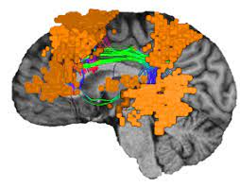
Other networks
Different methods and data have identified several other brain networks, many of which greatly overlap or are subsets of more well-characterized core networks.
Auditory
Right/left executive
Cerebellar
Spatial attention
Language
Lateral visual
Temporal
Visual perception/imagery
Language network

Slide 11
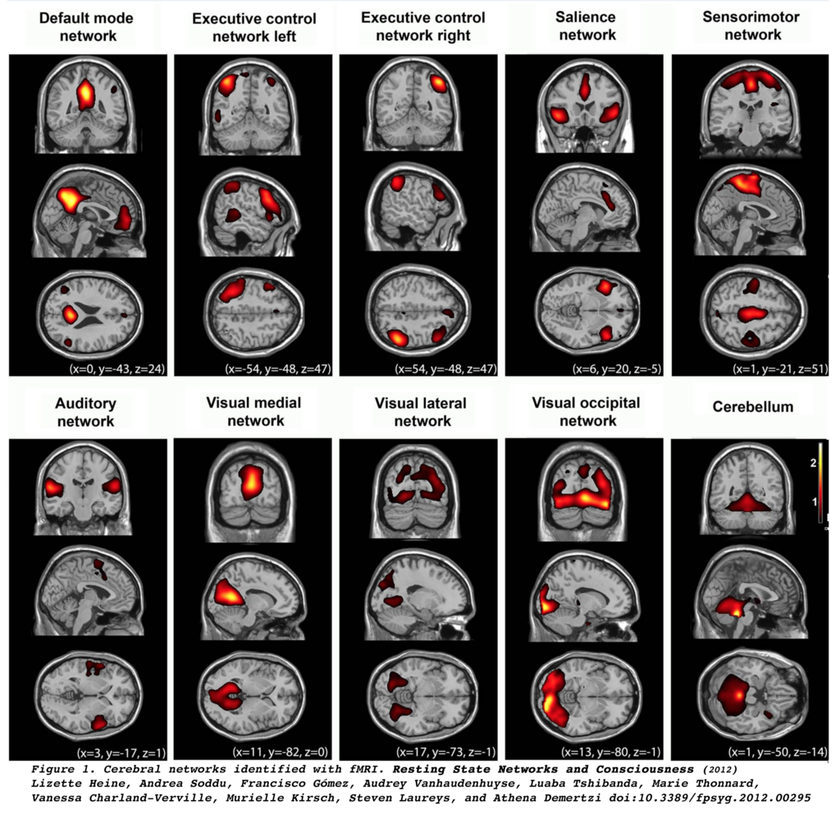
10 large-scale brain networks from resting state fMRI activity through independent component analysis

Slide 12
Thank You!

